Slide 1

Political System in India
Created by
ABDUL WAJID

Slide 2
Overview of the Political System
Executive Branch
Legislative Branch
Judicial Branch
The President is the head of state, while the Prime Minister is the head of government. The executive branch also includes the Council of Ministers, who aid and advise the President.
The Parliament of India consists of the President and two Houses - the Rajya Sabha (Council of States) and the Lok Sabha (House of the People). It is responsible for making laws and overseeing the executive.
The Supreme Court is the highest judicial body in India, responsible for upholding the Constitution and adjudicating disputes between the central government and state governments or among states.

Slide 3
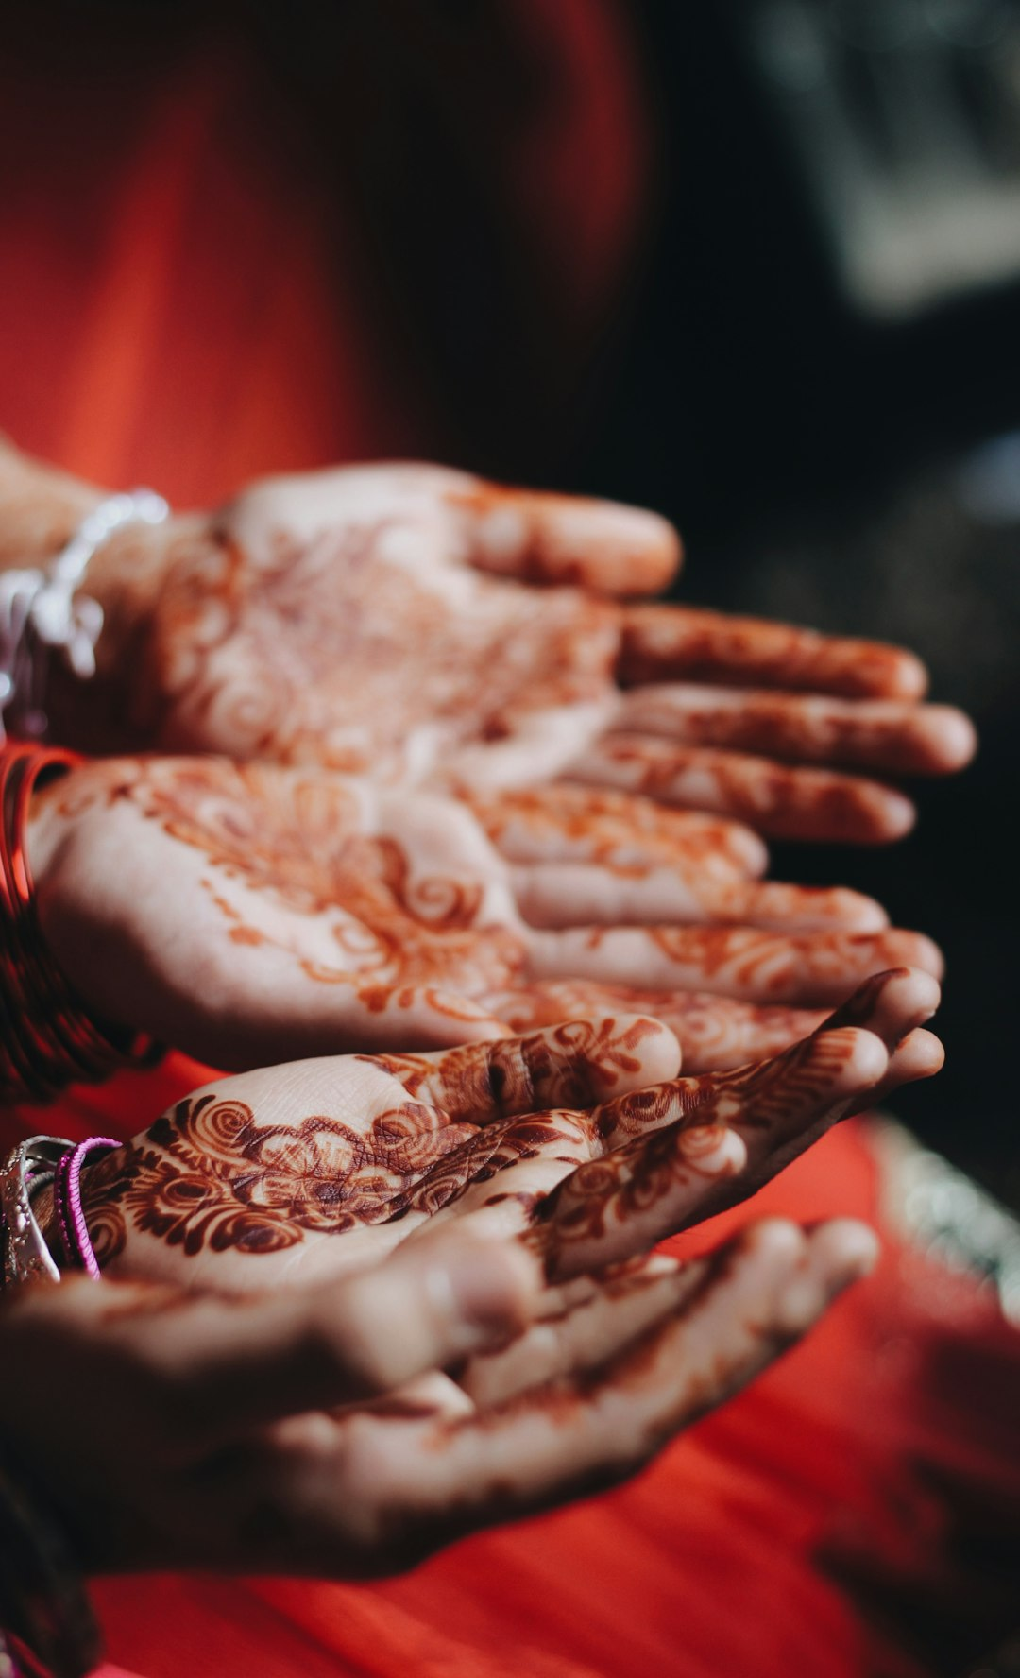
Key Government Institutions
Roles and Functions
The President serves as the ceremonial head of the country, while the Prime Minister leads the Council of Ministers and executes the powers vested in the President. The Parliament, comprising the President and two Houses, enacts laws and scrutinizes the government's functioning.
Photos provided by Unsplash

Slide 4

Political Parties
Major Political Parties
The Indian National Congress, founded in 1885, is one of the oldest political parties in India and has played a significant role in the country's history. The Bharatiya Janata Party (BJP) is currently the ruling party and espouses nationalism, conservatism, and social conservatism.
Photos provided by Unsplash

Slide 5
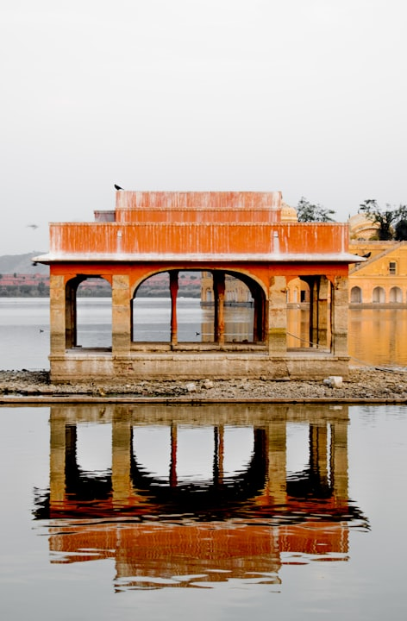
Electoral Process and Voting System
Significance of Elections
India's electoral process involves universal adult suffrage and a multi-phase polling system due to its vast population. Elections are vital in ensuring a democratic representation of diverse social, cultural, and political perspectives.
Photos provided by Unsplash

Slide 6
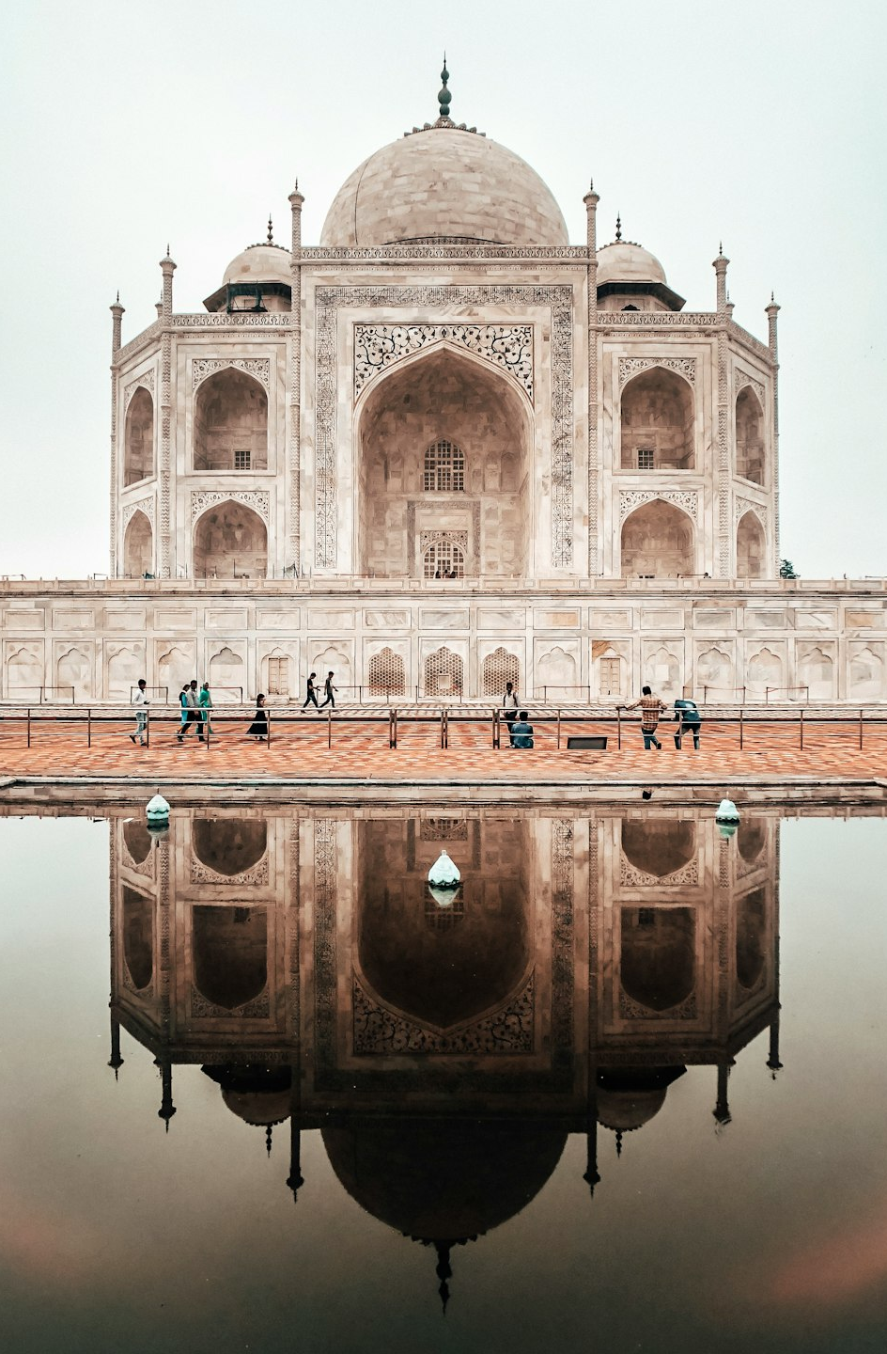
Challenges and Reforms
Challenges and Proposed Reforms
The challenges faced by the Indian political system include corruption, political dynasties, and regionalism. Proposed reforms aim to enhance transparency, address electoral financing, and promote inner-party democracy.
Photos provided by Unsplash

Slide 7
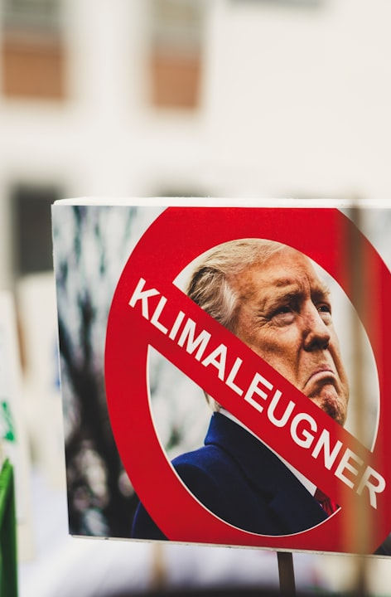
Conclusion and Q&A
Key Points Summary
The presentation highlighted the structure of the political system in India, the role of major institutions, political parties, the electoral process, and challenges facing the system. This is followed by an open forum for questions and discussions.
Photos provided by Unsplash

